Slide 1

K-12 Microelectronic Workshop Arduino Programming
1 struct instructor {
2 String name = “Yi Liu”;
3 String department = “Mechanical Engineering”;
4 String university = “University of Vermont”;
5 }

Slide 2
Contents
4. Sensors
4.1 HC-SR04 ultrasonic sensor
4.2 DHT22 temperature and humidity sensor
4.3 Summary

Slide 3
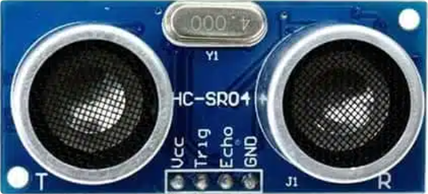
4.1 HC-SR04 ultrasonic sensor

Slide 4
4.1 HC-SR04 ultrasonic sensor
Transmitter

Slide 5
4.1 HC-SR04 ultrasonic sensor
Transmitter
Receiver

Slide 6
4.1 HC-SR04 ultrasonic sensor
Transmitter
Pins
Receiver

Slide 7
4.1 HC-SR04 ultrasonic sensor
measure distance by utilizing ultra-sonic waves
distance
T
R
HC-SR04
obstacle

Slide 8
4.1 HC-SR04 ultrasonic sensor
measure distance by utilizing ultra-sonic waves
transmitter emits ultrasonic sounds, and the echo pin is automatically pulled to HIGH
distance
T
R
HC-SR04
obstacle

Slide 9
4.1 HC-SR04 ultrasonic sensor
measure distance by utilizing ultra-sonic waves
transmitter emits ultrasonic sounds, and the echo pin is automatically pulled HIGH
sound waves bounce back if it hits an obstacle
distance
T
R
HC-SR04
obstacle

Slide 10
4.1 HC-SR04 ultrasonic sensor
measure distance by utilizing ultra-sonic waves
transmitter emits ultrasonic sounds, and the echo pin is automatically pulled HIGH
sound waves bounce back if it hits an obstacle
receiver receives the reflected sound, and the echo pin is automatically pulled LOW
measure the duration of echo pin stays HIGH
distance
T
R
HC-SR04
obstacle

Slide 11

4.1 HC-SR04 ultrasonic sensor
measure distance by utilizing ultra-sonic waves
transmitter emits ultrasonic sounds, and the echo pin is automatically pulled HIGH
sound waves bounce back if it hits an obstacle
receiver receives the reflected sound, and the echo pin is automatically pulled LOW
measure the duration of echo pin stays HIGH
distance
T
R
HC-SR04
obstacle
$$distance=\frac{duration}{2}×340 m/s$$

Slide 12
4.1 HC-SR04 ultrasonic sensor
7_UltrasonicSensor.ino — setup()
1 const int trigPin = 12;
2 const int echoPin = 13;
3
4 long duration;
5 long distance;
6
7 void setup() {
8 pinMode(trigPin, OUTPUT);
9 pinMode(echoPin, INPUT);
10 Serial.begin(9600);
11 }

Slide 13
4.1 HC-SR04 ultrasonic sensor
7_UltrasonicSensor.ino — loop()
13 void loop() {
14 digitalWrite(trigPin, HIGH);
15 delayMicroseconds(10);
16 digitalWrite(trigPin, LOW);
17
18 duration = pulseIn(echoPin, HIGH);
19 distanceCm = duration * 0.034 / 2;
20
21 Serial.print(“Distance: ”);
22 Serial.print(distanceCm);
23 Serial.println(“cm”);
24
25 delay(100);
26 }

Slide 14
4.1 HC-SR04 ultrasonic sensor
Vcc
Trig
Echo
GND
5V
GND
Pin 12
Pin 13

Slide 15
4.1 HC-SR04 ultrasonic sensor
15 delayMicroseconds(10);
delay 10 microseconds to ensures the trigger pin stays HIGH for required time to trigger the transmitter

Slide 16

4.1 HC-SR04 ultrasonic sensor
Syntax:
delayMicroseconds(microseconds);
microseconds: int, time (in microseconds) to pause
1000 microseconds = 1 milliseconds
returns: void

Slide 17
4.1 HC-SR04 ultrasonic sensor
20 duration = pulseIn(echoPin, HIGH);
measure how long the echoPin stays HIGH

Slide 18
4.1 HC-SR04 ultrasonic sensor
20 duration = pulseIn(echoPin, HIGH);
measure how long the echoPin stays HIGH
recall the workflow:
echoPin state
HIGH
LOW
time

Slide 19
4.1 HC-SR04 ultrasonic sensor
20 duration = pulseIn(echoPin, HIGH);
measure how long the echoPin stays HIGH
recall the workflow:
transmitter emits sound wave, and echo pin is pulled HIGH
echoPin state
pulse sent
HIGH
LOW
time

Slide 20
4.1 HC-SR04 ultrasonic sensor
20 duration = pulseIn(echoPin, HIGH);
measure how long the echoPin stays HIGH
recall the workflow:
transmitter emits sound wave, and echo pin is pulled HIGH
sound wave bounced back after hitting an obstacle, and echo pin still stays HIGH
echoPin state
pulse sent
HIGH
LOW
time

Slide 21
4.1 HC-SR04 ultrasonic sensor
20 duration = pulseIn(echoPin, HIGH);
measure how long the echoPin stays HIGH
recall the workflow:
transmitter emits sound wave, and echo pin is pulled HIGH
sound wave bounced back after hitting an obstacle, and echo pin still stays HIGH
receiver receives the echo, and echo pin is pulled LOW
echoPin state
pulse sent
echo received
HIGH
LOW
time

Slide 22
4.1 HC-SR04 ultrasonic sensor
20 duration = pulseIn(echoPin, HIGH);
measure how long the echoPin stays HIGH
recall the workflow:
transmitter emits sound wave, and echo pin is pulled HIGH
sound wave bounced back after hitting an obstacle, and echo pin still stays HIGH
receiver receives the echo, and echo pin is pulled LOW
the duration that echo pin stays HIGH is what pulseIn(echoPin, HIGH) measures
echoPin state
pulse sent
echo received
HIGH
duration
LOW
time

Slide 23
4.1 HC-SR04 ultrasonic sensor
Syntax:
pulseIn(pin, value);
pin: int, the pin number to read the pulse
value: HIGH or LOW
returns: long, the length of the pulse, or 0 if no pulse

Slide 24
Contents
4. Sensors
4.1 HC-SR04 ultrasonic sensor
4.2 DHT22 temperature and humidity sensor
4.3 Summary

Slide 25
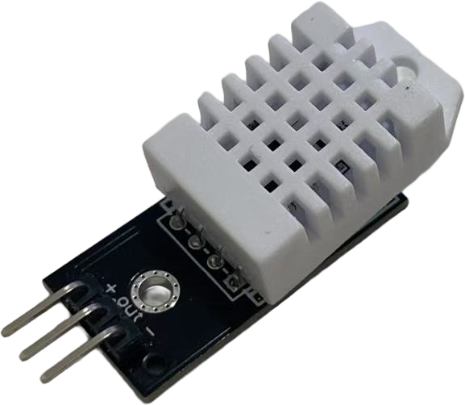
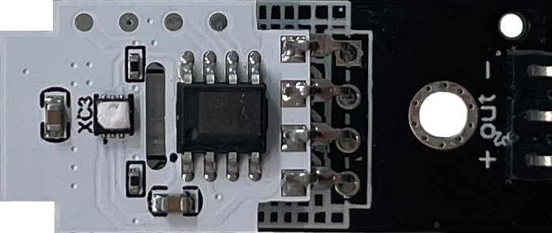
4.2 DHT22 temperature and humidity sensor

Slide 26
4.2 DHT22 temperature and humidity sensor
Sensor

Slide 27
4.2 DHT22 temperature and humidity sensor
Data processing chip
Sensor

Slide 28
4.2 DHT22 temperature and humidity sensor
Data processing chip
Pins
Sensor

Slide 29
4.2 DHT22 temperature and humidity sensor
8_TemperatureAndHumiditySensor.ino — setup()
1 #include “DHT.h”
2 const int dhtPin = 13;
3
4 DHT myDHT(dhtPin, DHT22);
5
6 float humidity;
7 float temperature;
8
9 void setup() {
11 Serial.begin(9600);
12 myDHT.begin();
13 }

Slide 30
4.2 DHT22 temperature and humidity sensor
8_TemperatureAndHumiditySensor.ino — loop()
14 void loop() {
15 humidity = myDHT.readHumidity();
16 temperature = myDHT.readTemperature();
17
18 Serial.print(“Humidity: ”);
19 Serial.println(humidity);
20 Serial.print(“Temperature: ”);
21 Serial.println(temperature);
22
23 delay(1000);
24 }

Slide 31
4.2 DHT22 temperature and humidity sensor
+
OUT
-
5V
GND
Pin 12

Slide 32
4.2 DHT22 temperature and humidity sensor
1 #include “DHT.h”
configuration and data fetching process is like HC-SR04 ultrasonic sensor, but more complicated

Slide 33
4.2 DHT22 temperature and humidity sensor
1 #include “DHT.h”
configuration and data fetching process is like HC-SR04 ultrasonic sensor, but more complicated
Arduino IDE provides large amount of libraries
click library management
type “DHT Sensor Library”
install all

Slide 34
4.2 DHT22 temperature and humidity sensor
4 DHT myDHT(dhtPin, DHT22);
the way to create a variable of class type

Slide 35
4.2 DHT22 temperature and humidity sensor
4 DHT myDHT(dhtPin, DHT22);
the way to create a variable of class type
create a DHT sensor object named myDHT
DHT is a class from “DHT.h”
myDHT is the name of the class and can be named anything
dhtPin tells which pin is being used
DHT22 tells the object device type

Slide 36
4.2 DHT22 temperature and humidity sensor
12 myDHT.begin();
initialize the sensor

Slide 37
4.2 DHT22 temperature and humidity sensor
15 humidity = myDHT.readHumidity();
16 temperature = myDHT.readTemperature();
the sensor can be easily fetched using these functions from the library

Slide 38

4.2 DHT22 temperature and humidity sensor
How do I know how to use this library???

Slide 39
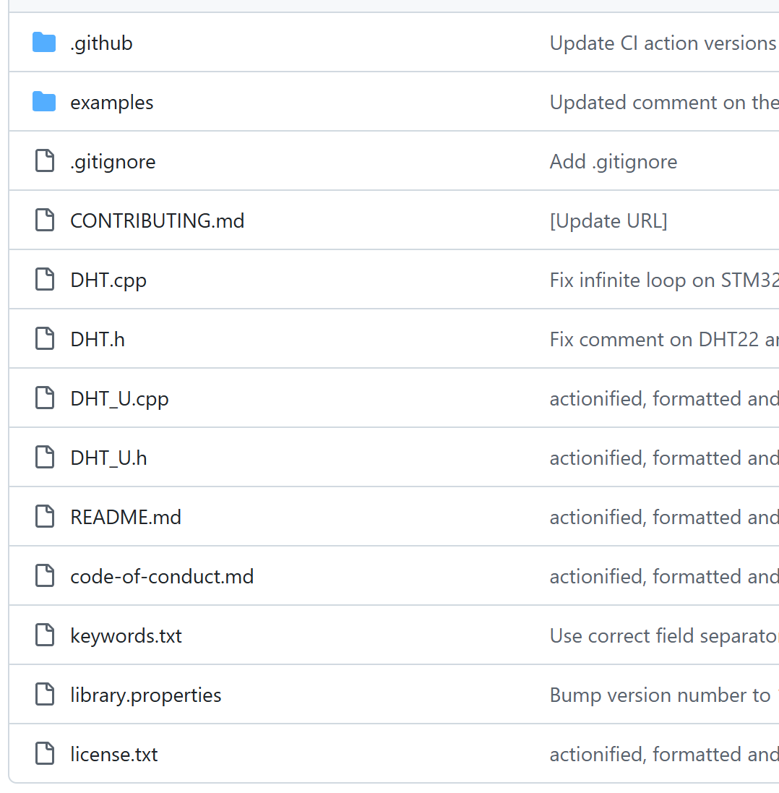
4.2 DHT22 temperature and humidity sensor
How do I know how to use this library???
check GitHub
README.md
keywords.txt

Slide 40
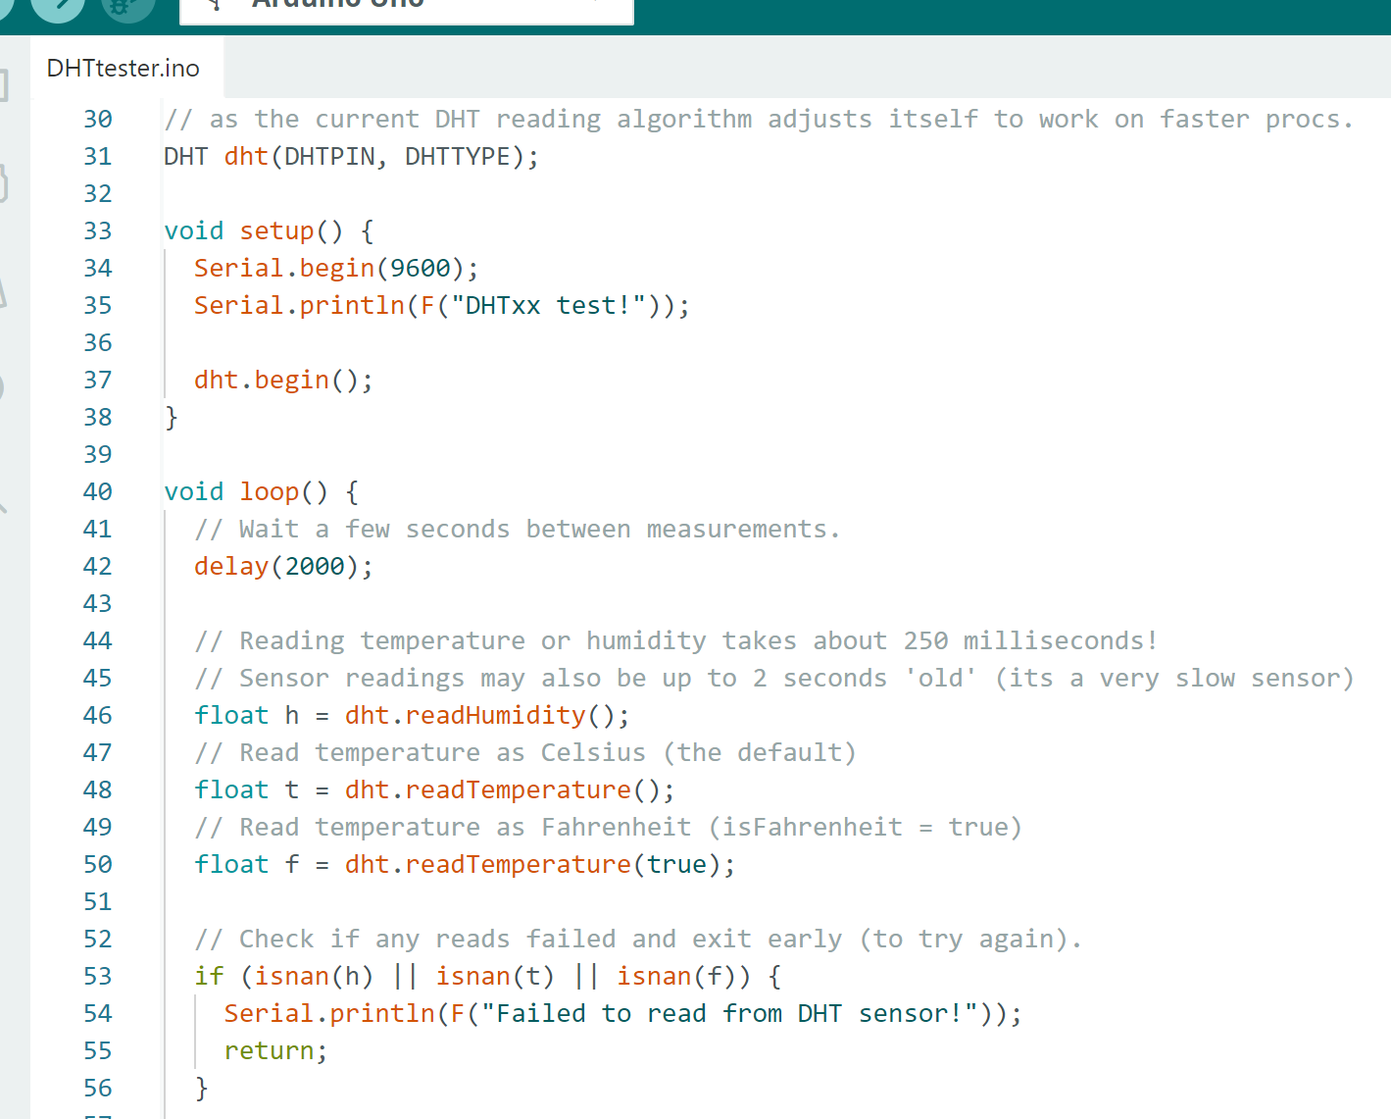
4.2 DHT22 temperature and humidity sensor
How do I know how to use this library???
check GitHub
README.md
keywords.txt
check examples
files → examples

Slide 41
Contents
4. Sensors
4.1 HC-SR04 ultrasonic sensor
4.2 DHT22 temperature and humidity sensor
4.3 Summary

Slide 42
4.3 Summary
HC-SR04 ultrasonic sensor

Slide 43
4.3 Summary
HC-SR04 ultrasonic sensor
components
transmitter
receiver

Slide 44
4.3 Summary
HC-SR04 ultrasonic sensor
components
transmitter
receiver
operating principle
transmitter sends pulse
receiver receives echo
calculate duration

Slide 45
4.3 Summary
DHT22 temperature and humidity sensor

Slide 46
4.3 Summary
DHT22 temperature and humidity sensor
components
humidity resistor
thermistor
data processing chip

Slide 47
4.3 Summary
DHT22 temperature and humidity sensor
components
humidity resistor
thermistor
operating principle
humidity changes resistance of humidity resistor
temperature changes resistance of thermistor
chip convert changes into digital signals

Slide 48
4.3 Summary
time
delayMicroseconds(microseconds)
advanced I/O
pulseIn(pin, value)
DHT22 “DHT.h”
DHT myDHT(pin, type)
myDHT.begin();
myDHT.readHumidity();
myDHT.readTemperature();

Slide 49
K-12 Microelectronic Workshop Arduino Programming
1 Serial.println(“Thank you!”);

